Slide 1
The Anatomy of a Pivot Table
RX 319
Introduction to Healthcare Analytics

Slide 2
Learning Objectives
Describe the purpose of a pivot table.
Identify the elements of a pivot table.
2

Slide 3
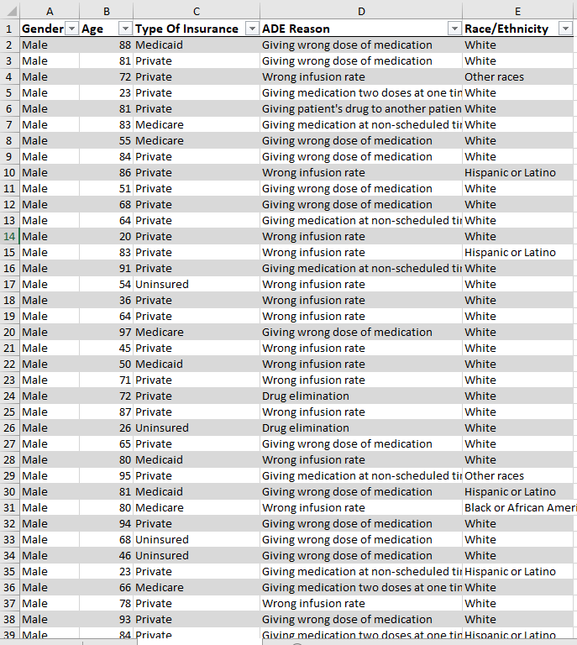
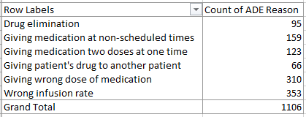
What is a Pivot Table?
A pivot table lets you convert from a long data set to an informative data summary
Long Data Set
Pivot Table
Rows
Values
The “Groups” you want to use to split your data
How do you want to summarize your data?
Examples: Count, Sum, Average
3
3

Slide 4
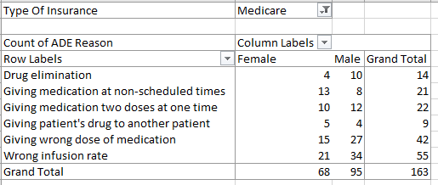
A slightly more complicated pivot table
Filter
Columns
Rows
Values
4

